Slide 1
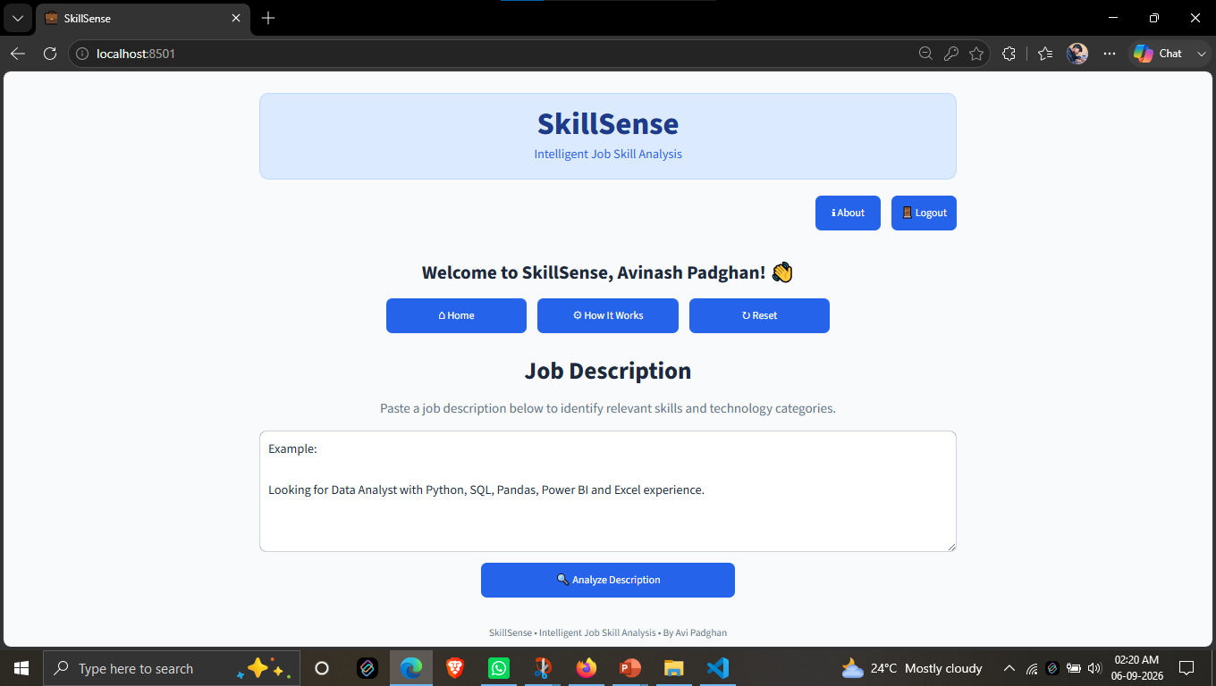
SKILLSENSE
WEB APPLICATION
INTELLIGENT JOB SKILL ANALYSIS
An NLP-Based System for Extracting and Analyzing Skills from Job Descriptions
PRESENTED BY: AVINASH PADGHAN
Live project interface
AI • NLP • SKILL INTELLIGENCE
SkillSense • Intelligent Job Skill Analysis | 1

Slide 2
PROBLEM STATEMENT
Job descriptions contain valuable skill information, but extracting and analyzing these skills manually is time-consuming and inconsistent.
01
02
Manual Extraction
Unstructured Information
Identifying required skills from lengthy job descriptions requires significant manual effort.
Skills are mixed with responsibilities, qualifications, experience, and tools.
03
04
Difficult at Scale
Limited Context
Analyzing large volumes of job descriptions manually is inefficient.
Keyword-based methods can miss related or context-specific skills.
PROJECT NEED → Automate skill extraction, categorization and analysis using NLP.
SkillSense • Intelligent Job Skill Analysis | 2

Slide 3
BUSINESS USE CASE
Turning unstructured job descriptions into actionable skill insights.
01
02
03
04
Recruitment & Hiring
Skill Gap Analysis
Job Market Analysis
Career & Learning
Support faster screening by identifying required skills.
Compare job requirements with candidate skill profiles.
Study skill demand across roles and technologies.
Guide relevant upskilling and learning decisions.
BUSINESS VALUE
Faster Analysis • Better Skill Insights • Data-Driven Decisions
SkillSense • Intelligent Job Skill Analysis | 3

Slide 4
DATASET
01
TOTAL RECORDS
DATA CONTENT
4,318
• Job descriptions • Job roles / titles • Education and experience information • Required skills and technologies
job descriptions
DOMAIN Job & Recruitment PRIMARY TASK Skill extraction & analysis
02
TARGET OUTPUT
Structured skill information extracted from unstructured job-description text for downstream analysis and modeling.
SkillSense • Intelligent Job Skill Analysis | 4

Slide 5
DATA CLEANING
01
02
03
04
05
Raw Text
Text Cleaning
Preprocessing
Skill Normalization
Clean Dataset
→
→
→
→
Original job descriptions
Remove noise, normalize text and whitespace
Prepare text for NLP feature extraction
Standardize skill names and variants
Ready for analysis and modeling
Goal: improve consistency, reduce noise and make the text suitable for NLP models.
SkillSense • Intelligent Job Skill Analysis | 5

Slide 6
EXPLORATORY DATA ANALYSIS
Understanding the dataset before building NLP models.
01
02
Job Roles
Education
Distribution of job titles and role categories.
Comparison of education requirements across records.
03
04
Skill Demand
Text Characteristics
Frequency of commonly required skills.
Length and content patterns in job descriptions.
EDA INSIGHT → These patterns help define useful features, categories and dashboard views.
SkillSense • Intelligent Job Skill Analysis | 6

Slide 7
NLP PIPELINE
01
02
03
04
05
06
→
→
→
→
→
Job Description
Text Preprocessing
Skill Detection
Feature Extraction
Modeling
Skill Insights
Rule-Based • Machine Learning • Transformer-Based NER • Skill Normalization
SkillSense • Intelligent Job Skill Analysis | 7

Slide 8
RULE-BASED APPROACH
Known-skill matching with dictionary and pattern-based methods.
01
02
03
Phrase Matching
Skill Dictionary
Normalization
spaCy PhraseMatcher detects known skills and skill phrases.
A predefined vocabulary identifies technical and non-technical skill mentions.
Detected variants are mapped to standardized skill names.
SKILL EXTRACTION PERFORMANCE
Method
Accuracy
Precision
Recall
Dictionary
0.620
0.583
0.620
0.601
Regex
0.052
0.567
0.052
0.096
Measured on the final skill extraction comparison.
SkillSense • Intelligent Job Skill Analysis | 8

Slide 9
MACHINE LEARNING APPROACH
TF-IDF + Logistic Regression for skill-category classification.
JOB TEXT
→
TF-IDF
→
LOGISTIC REGRESSION
→
SKILL CATEGORY
MODEL RESULT
CLASSIFICATION REPORT — KEY RESULT
0.2143
Accuracy
SKILL class: precision 0.21 • recall 1.00 • F1 0.35
14 test samples
Macro avg F1: 0.04 • Weighted avg F1: 0.08
SkillSense • Intelligent Job Skill Analysis | 9

Slide 10
TRANSFORMER APPROACH
Entity-level skill extraction using a DistilBERT NER pipeline.
01
02
03
MODEL
EXTRACTION
DEPLOYMENT READY
DistilBERT-based NER pipeline using dslim/distilbert-NER.
Token classification identifies entities from job-description text; aggregation groups token pieces.
The model can be stored locally with configuration, weights and tokenizer files.
SKILL EXTRACTION PERFORMANCE
TOKEN OUTPUT EXAMPLE
Transformer
Accuracy 0.636 | Precision 0.916 | Recall 0.636 | F1 0.751
del → ORG 0.943 ##oit → ORG 0.979 ##te → ORG 0.984
SkillSense • Intelligent Job Skill Analysis | 10

Slide 11
FINAL SKILL EXTRACTION COMPARISON
Performance across four skill extraction methods.
Method
Accuracy
Precision
Recall
F1 Score
Dictionary
0.620
0.583
0.620
0.601
Regex
0.052
0.567
0.052
0.096
Semantic Similarity
0.036
0.852
0.036
0.069
Transformer
0.636
0.916
0.636
0.751
BEST OVERALL EXTRACTION RESULT → Transformer: Accuracy 0.636 • Precision 0.916 • Recall 0.636 • F1 0.751
SkillSense • Intelligent Job Skill Analysis | 11

Slide 12
ERROR ANALYSIS
01
Ambiguous Terms
02
Unseen Skills
A term may have different meanings depending on job context.
Skills not represented in training vocabulary or patterns can be missed.
03
Tokenization
04
Similar Entities
Subword tokenization can split skill names across multiple tokens.
Related technologies or phrases can be difficult to separate precisely.
Observed transformer tokenization example: del / ##oit / ##te were classified as ORG.
SkillSense • Intelligent Job Skill Analysis | 12

Slide 13
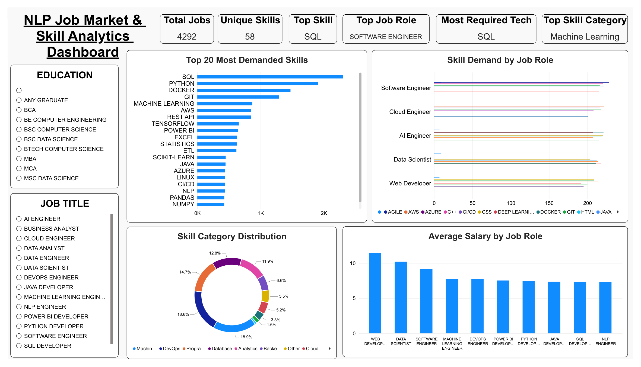
DASHBOARD
NLP Job Market & Skill Analytics — Power BI Dashboard
Dashboard highlights: 4,292 total jobs • 58 unique skills • Top skill: SQL • Top job role: Software Engineer • Top category: Machine Learning
SkillSense • Intelligent Job Skill Analysis | 13

Slide 14
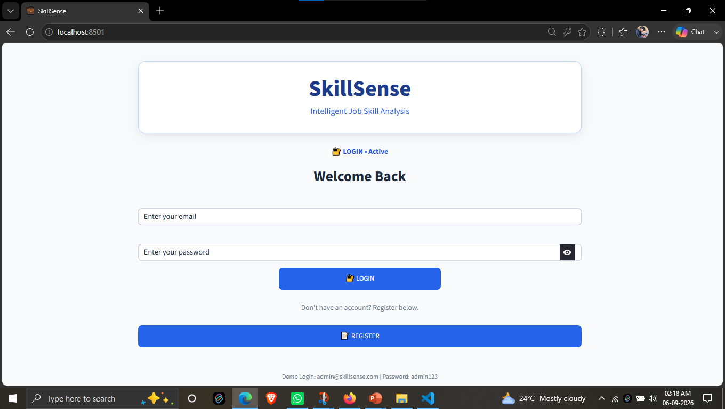
APPLICATION DEMO
SkillSense web application for intelligent job-description analysis.
01 LOGIN
02 ANALYSIS HOME
LOGIN → ENTER JOB DESCRIPTION → ANALYZE → VIEW SKILL RESULTS
SkillSense • Intelligent Job Skill Analysis | 14

Slide 15
CONCLUSION
01
02
03
Automated Analysis
Multiple Approaches
Actionable Insights
NLP can reduce the manual effort required to identify skills in job descriptions.
Rule-based, classical ML and transformer methods provide complementary capabilities.
Extracted skills can support recruitment, market analysis and career decisions.
SkillSense bridges unstructured job text and structured skill intelligence.
SkillSense • Intelligent Job Skill Analysis | 15

Slide 16
FUTURE IMPROVEMENTS
01
02
Domain Fine-Tuning
Skill Ontology
Fine-tune transformer models on domain-specific job-description data.
Build a richer skill taxonomy with related skills, aliases and technology families.
03
04
Advanced Matching
Live Market Insights
Add resume-to-job skill matching and automated skill-gap scoring.
Integrate updated job data to monitor changing skill demand over time.
THANK YOU
SkillSense • Intelligent Job Skill Analysis | 16

